Slide 1
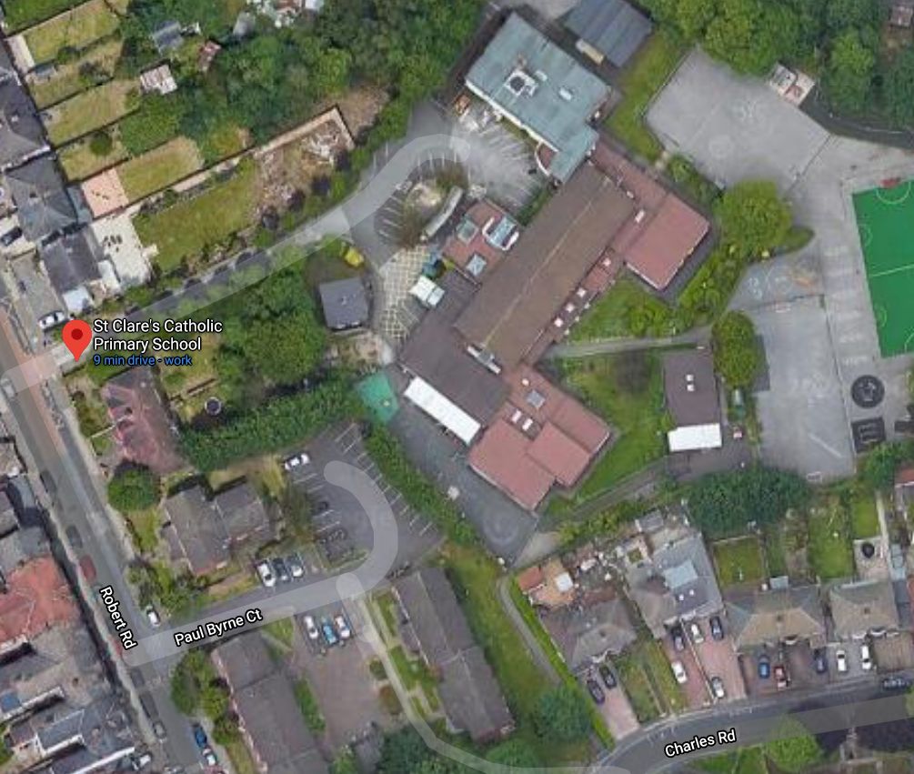
Morning and End of the day information
(see duties on the following pages).
End of the day
EXIT ROUTE
 | St Alphonsa, St Martin and St Thomas entry and exit.
 | St Andrew and St Patrick entry and exit.
 | St Cecilia and St John Paul II entry and exit.
 | St Rose and St Therese entry and exit.
 | St Elizabeth entry and exit.
Children only in the mornings.

Slide 2
End of the day procedures
Children in St Patrick and St Andrew’s classes will exit from the St Patrick’s class door at 3pm.
Children from St Rose’s class exit from the morning entrance door at 3pm (be prompt).
Children from St Therese’s class will exit from the morning entrance door at 3:10pm (wait for Y2).
Children from St Cecilia and St John Paul II’s classes will be dismissed from the top of the drive at 3:10pm.
Children from St Martin and St Thomas’ classes will be dismissed from outside the front entrance at 3.10pm – parents please wait on the pavement by the caretaker’s house.
Children from St Alphonsa and St Elizabeth’s classes will walk down the drive at 3:10pm and be dismissed from the bottom of the drive.
The children must stay in their line and not bunch up, this will need strict monitoring.
Parents can enter by both gates but only leave by the Robert Road gate.
Booking appointments for parents/carers.
If you need to speak to a parent or carer this must be done by telephone or email in the first instance. These need to be logged in the same way we recorded during lockdown.
Full Name (Child) Sibling information to be added. | Tel: | Speak to: | Internet Access: Email Address Using Google Classroom? | Report email sent Receipt received | September | October
 |  |  |  | Hand given: 13/07/20 | Returned to school on

Slide 3
Classroom hygiene
Children will clean their hands on arrival with hand gel. Once in class send children to wash their hands in the toilets – this needs timetabling and repeating throughout the day – work with the other classes using the same toilets.
Doors will be wedged open to reduce handling – including class doors where possible.
Adults need to wipe any communal item/furniture such as sinks at regular intervals (or any share resources such as whiteboard pens).
Windows will remain open where possible.
Teachers need to establish clear hygiene rules with the class e.g. no touching each other or other people’s equipment; no touching own face; handwashing whenever they forget; maintain social distance as far as possible
Teachers will devise and practise social distance games
Tissues and bins will be available in all classrooms
Hand gel will be available in the classroom, but this is not a replacement for good handwashing.
Class | Toilets | Class | Toilets
St Elizabeth | Own toilets | St Alphonsa | Girls – Upstairs toilets Boys – Lower boys toilets
St Martin / St Thomas | Upper corridor toilets | St Cecilia / St John Paull II | Mixed – Lower Girls toilets
St Rose / St Therese | Year 3 corridor toilets | St Andrew / St Patrick | Infant toilets
Reception / Nursery | Own toilets

Slide 4
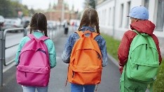
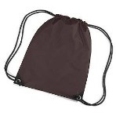
Children’s equipment
To support school in staying as safe as possible there will be the following changes:
No pencil cases or toys are to be brought into school from home (equipment will be provided from each child at school in an individual pack)
No rucksacks are to be brought to school
P.E. kits must be in a small draw string bag clearly labelled with the child’s full name
Small book bags for homework and reading books will be permitted
If your child brings their own lunch this must be in a small lunch box clearly labelled, as these will be kept under their table during the day.
A clearly labelled water bottle, which must be taken home and washed every day.
Infant children must have a school dinner - lunch boxes will not be allowed on site for Reception to Year 2

Slide 5
Classroom Resources ​
Each child will have a tray with their own stationary. This needs to be accounted for at the end of every session.
Other equipment will be provided on an individual basis. If rotation is needed, (e.g. paint brushes) it will be cleaned before being used by another child.​
Reading/library books: Children will keep a reading books and a class library book in their trays​
Change books once per week – returns to go into a box and not be touched for 72 hours
Coats will be kept on the back of chairs for Y3 to Y6 to avoid cloakroom congestion​. Children in younger classes to use
cloakrooms - more spaced out.
Children may bring a clear plastic bottle of water each day but this must be labelled with name and washed in boiled water at home before it comes in the following day.
Book corners with soft furnishings should not be used at the moment.
Think carefully about how the children’s books are handed and collected in for each lesson.
Staff movement around class.
Gui​dance suggests that you reduce movement around the classroom but that it is okay for teachers and teaching assistants to work with children but that this is limited to 15mins at a time.
Staff who cover classes or who work between rooms should always wash their hands or use hand gel between classrooms. It may also be worth having your own set of pens etc. in each room.

Slide 6
Lunchtime
Knives and forks will be set out on tables by a key lunchtime supervisor who will supervise their own group and will not mix across groups. Cups of water will be pre-filled ready for the children. Teachers and teaching assistants will stay with their class until they have all collected their meals. The children will go straight to their allocated tables and ‘bubbles’ will not be mixed. Children will be called a table at time to choose their meal. Children will leave their trays on the table and these will be cleared by their named LTS.
Classes will enter the dining hall through the corridors and exit through the infant playground door which will be wedged open and monitored by a lunchtime supervisor.
Class | Time
Reception / Nursery | 12:00 (earlier for a while) | Staff to stay until 12:15pm. Collect children at 1:00pm
Lower Juniors | 12:15 (maybe in 5 minute intervals from 12:10 – 12:20 | Collect children at 1:00pm
Year 2 | 12:25pm | Collect children at 1:10pm
St Andrew / St Patrick | 12:30pm | Collect children at 1:15pm
Year 5 and 6 | 12:40pm | Collect children at 1:25pm
These arrangements and timings may need some alterations after we have tried them in reality with the children.
Infant children will in general not be eating packed lunches. Junior children will bring their own packed lunch box to the hall.

Slide 7
Illness
Children or staff who show symptoms of any illness must not come to school. If any member of the family has symptoms of the Covid 19 virus, the children should stay at home for 14 days.
If any child becomes ill whilst in school they will be looked after in isolation until the parent comes to collect them. Parents should seek a test by ringing 119. If it is thought the child has the Covid 19 virus, all children and staff in the class will be advised to isolate at home for 14 days.
PPE will be available for staff who are looking after any child who is ill.
https://www.gov.uk/guidance/coronavirus-covid-19-getting-tested
If a child becomes ill in school
1 staff member from the bubble will escort the child to the junior disabled toilet (maintaining 2m distance and trying to ensure that the child does not touch any doors/surfaces. This member of staff will then put on PPE to look after any needs the child has. The front meeting room has been set aside for this purpose and must not be used for anything else. Leaving the door wedged open the member of staff need to inform the office via the hatch so that the child’s parent can be asked to collect the child immediately. All waste including discarded PPE must be bagged/ up using the new clinical bags.
Blue roll and gloves will be available in all classrooms.
Symptoms flow chart

Slide 8
Main symptoms
The main symptoms of coronavirus are:
high temperature – this means you feel hot to touch on your chest or back (you do not need to measure your temperature)
new, continuous cough – this means coughing a lot for more than an hour, or 3 or more coughing episodes in 24 hours (if you usually have a cough, it may be worse than usual)
loss or change to your sense of smell or taste – this means you've noticed you cannot smell or taste anything, or things smell or taste different to normal
Most people with coronavirus have at least one of these symptoms.

