Slide 1
Catholic Life of St Clare’s Catholic Primary

Slide 2
St Clare’s Catholic Primary School
Our Mission Statement We welcome everyone into our community in order to live, love and learn together in the light and example of the life of Christ.

Slide 3
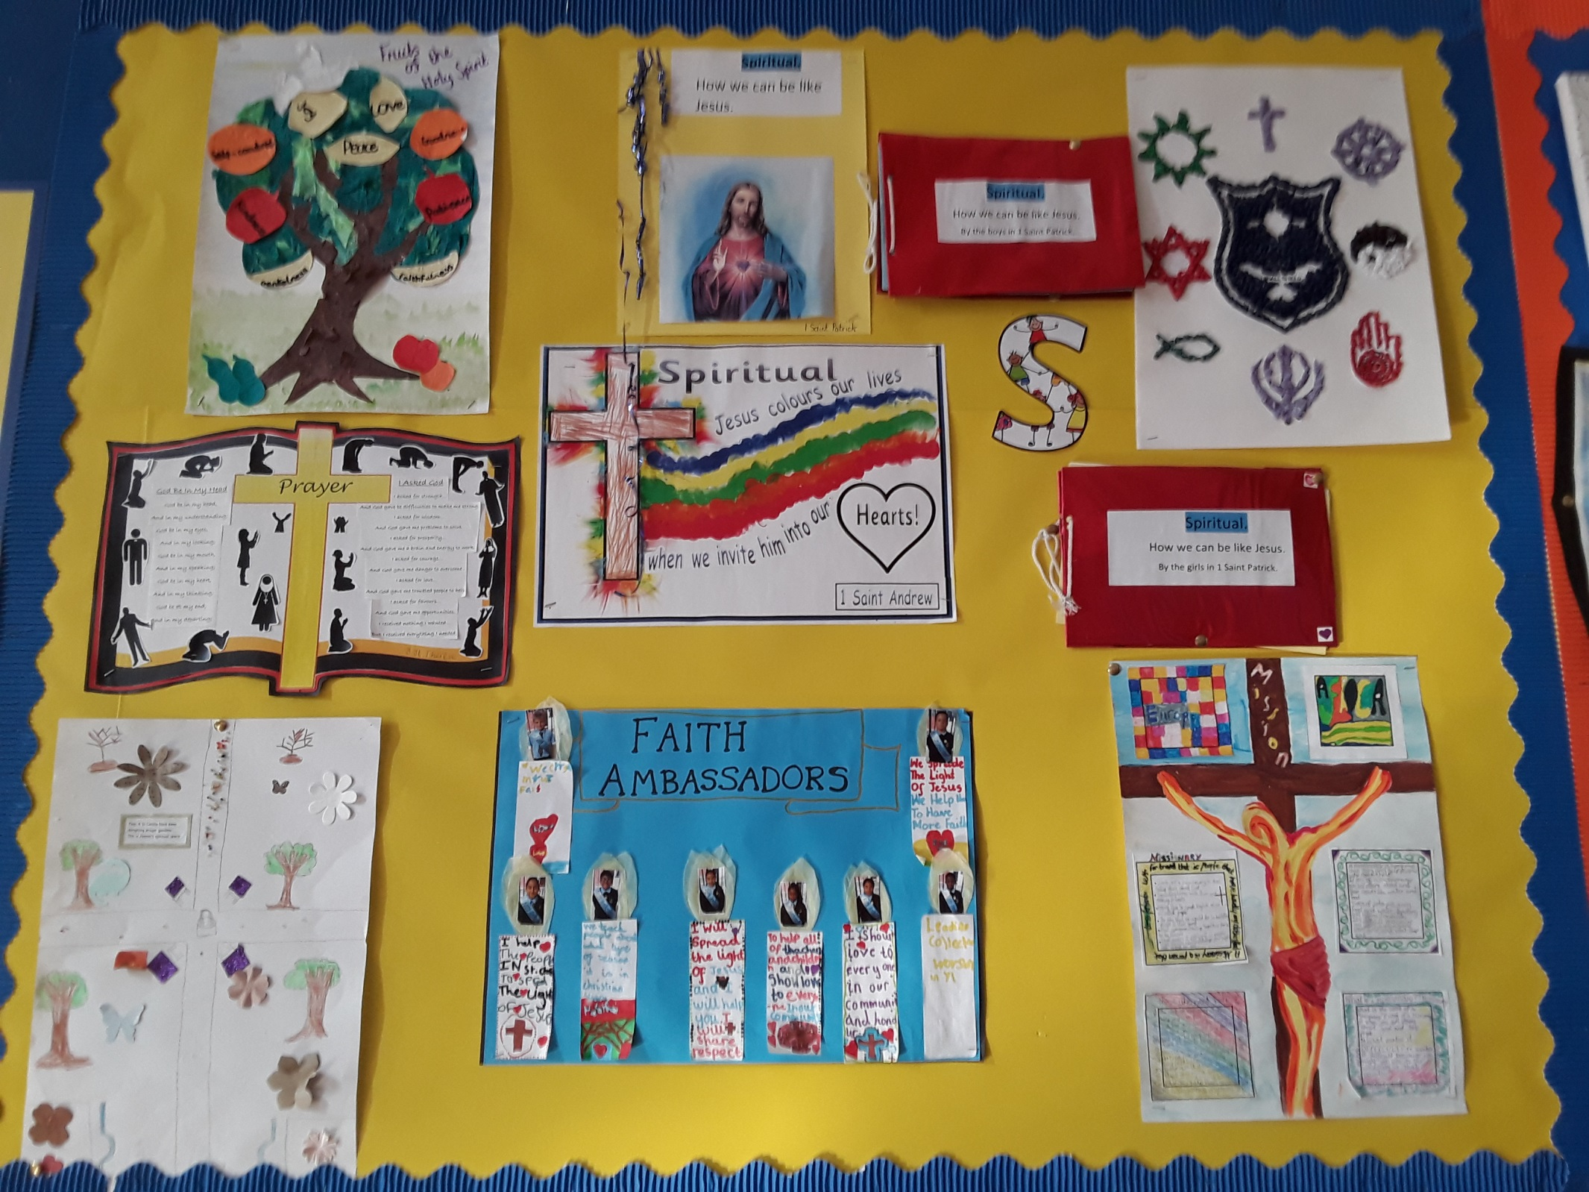

Slide 6
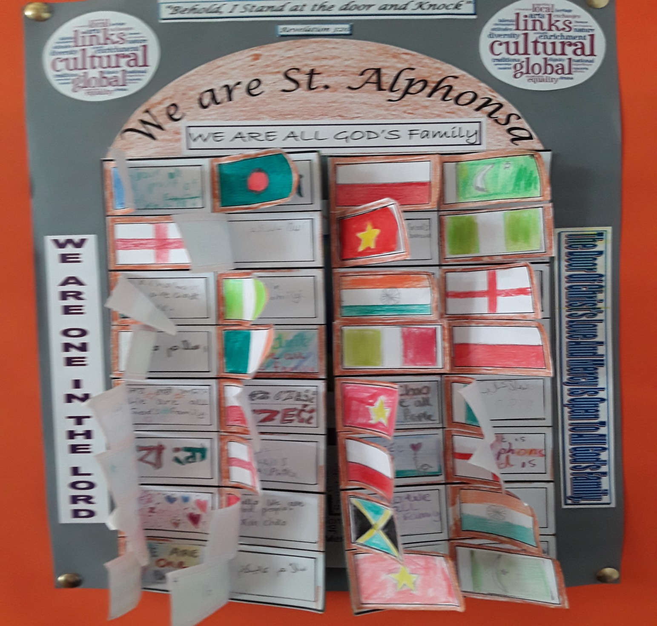

Slide 7
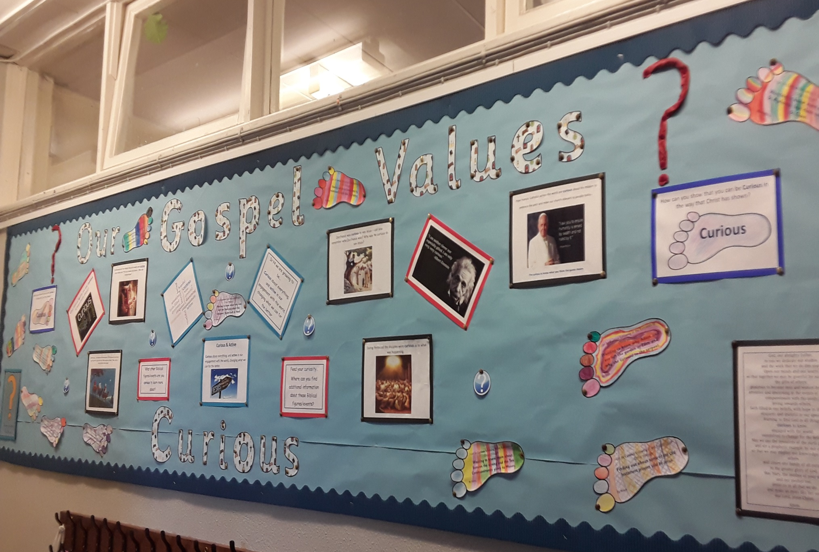

Slide 10
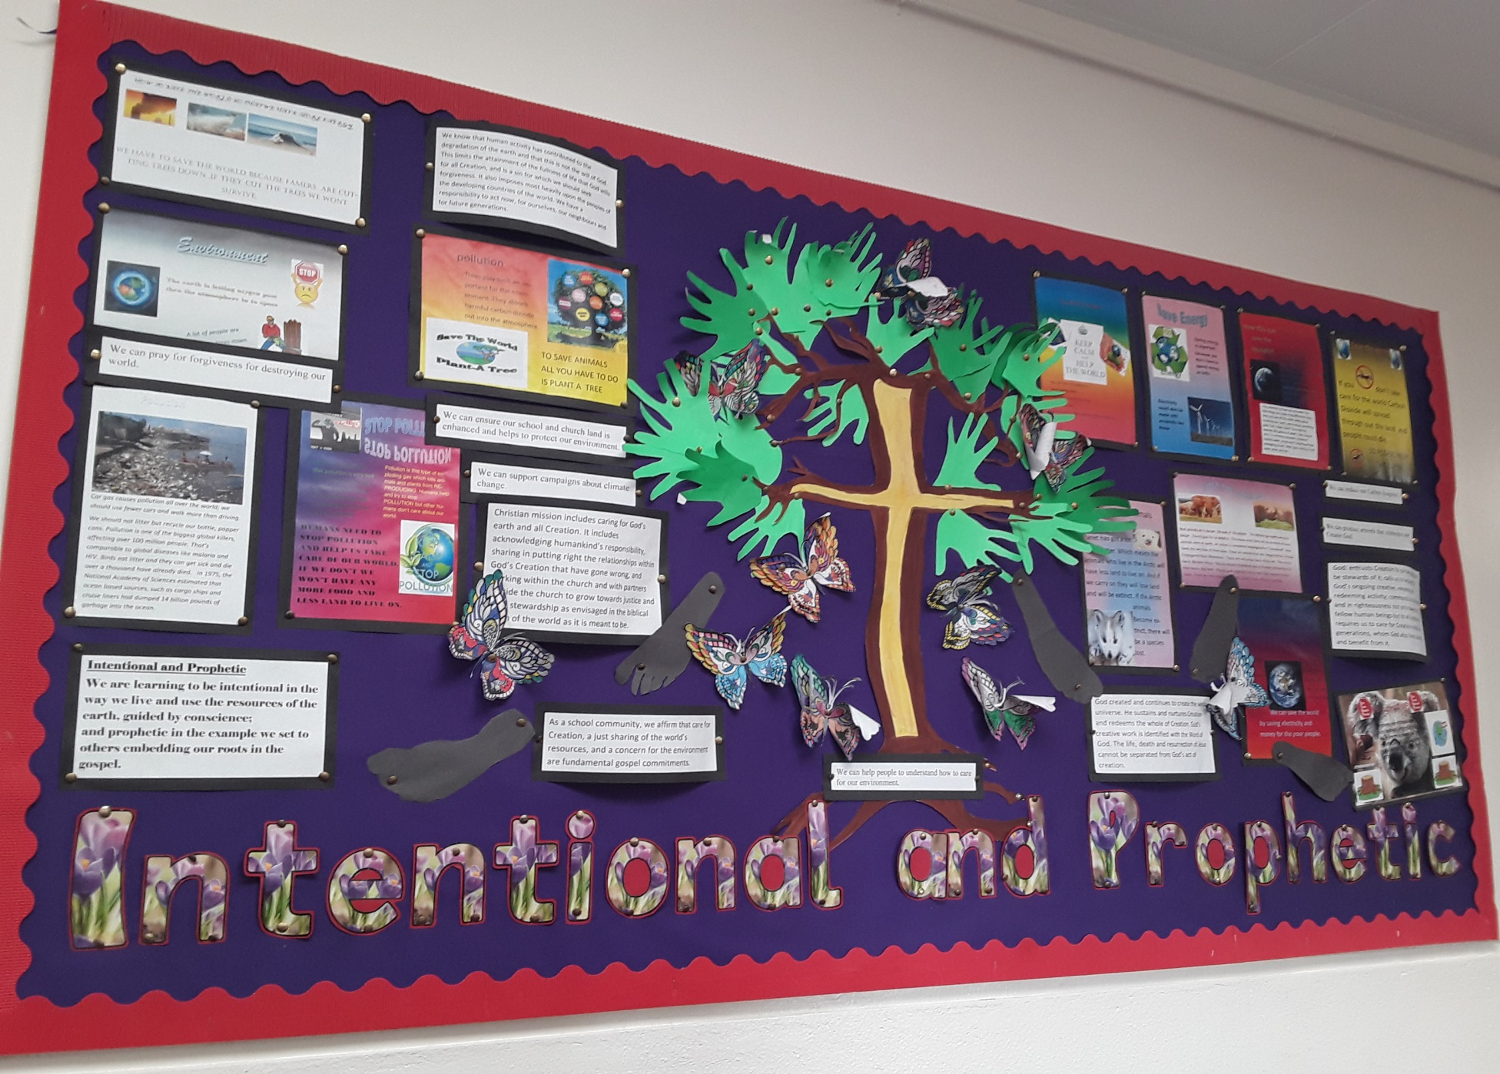

Slide 11
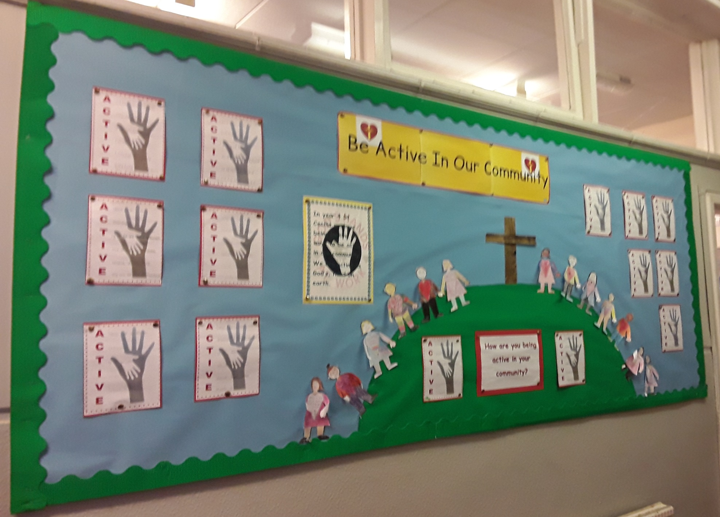

Slide 12
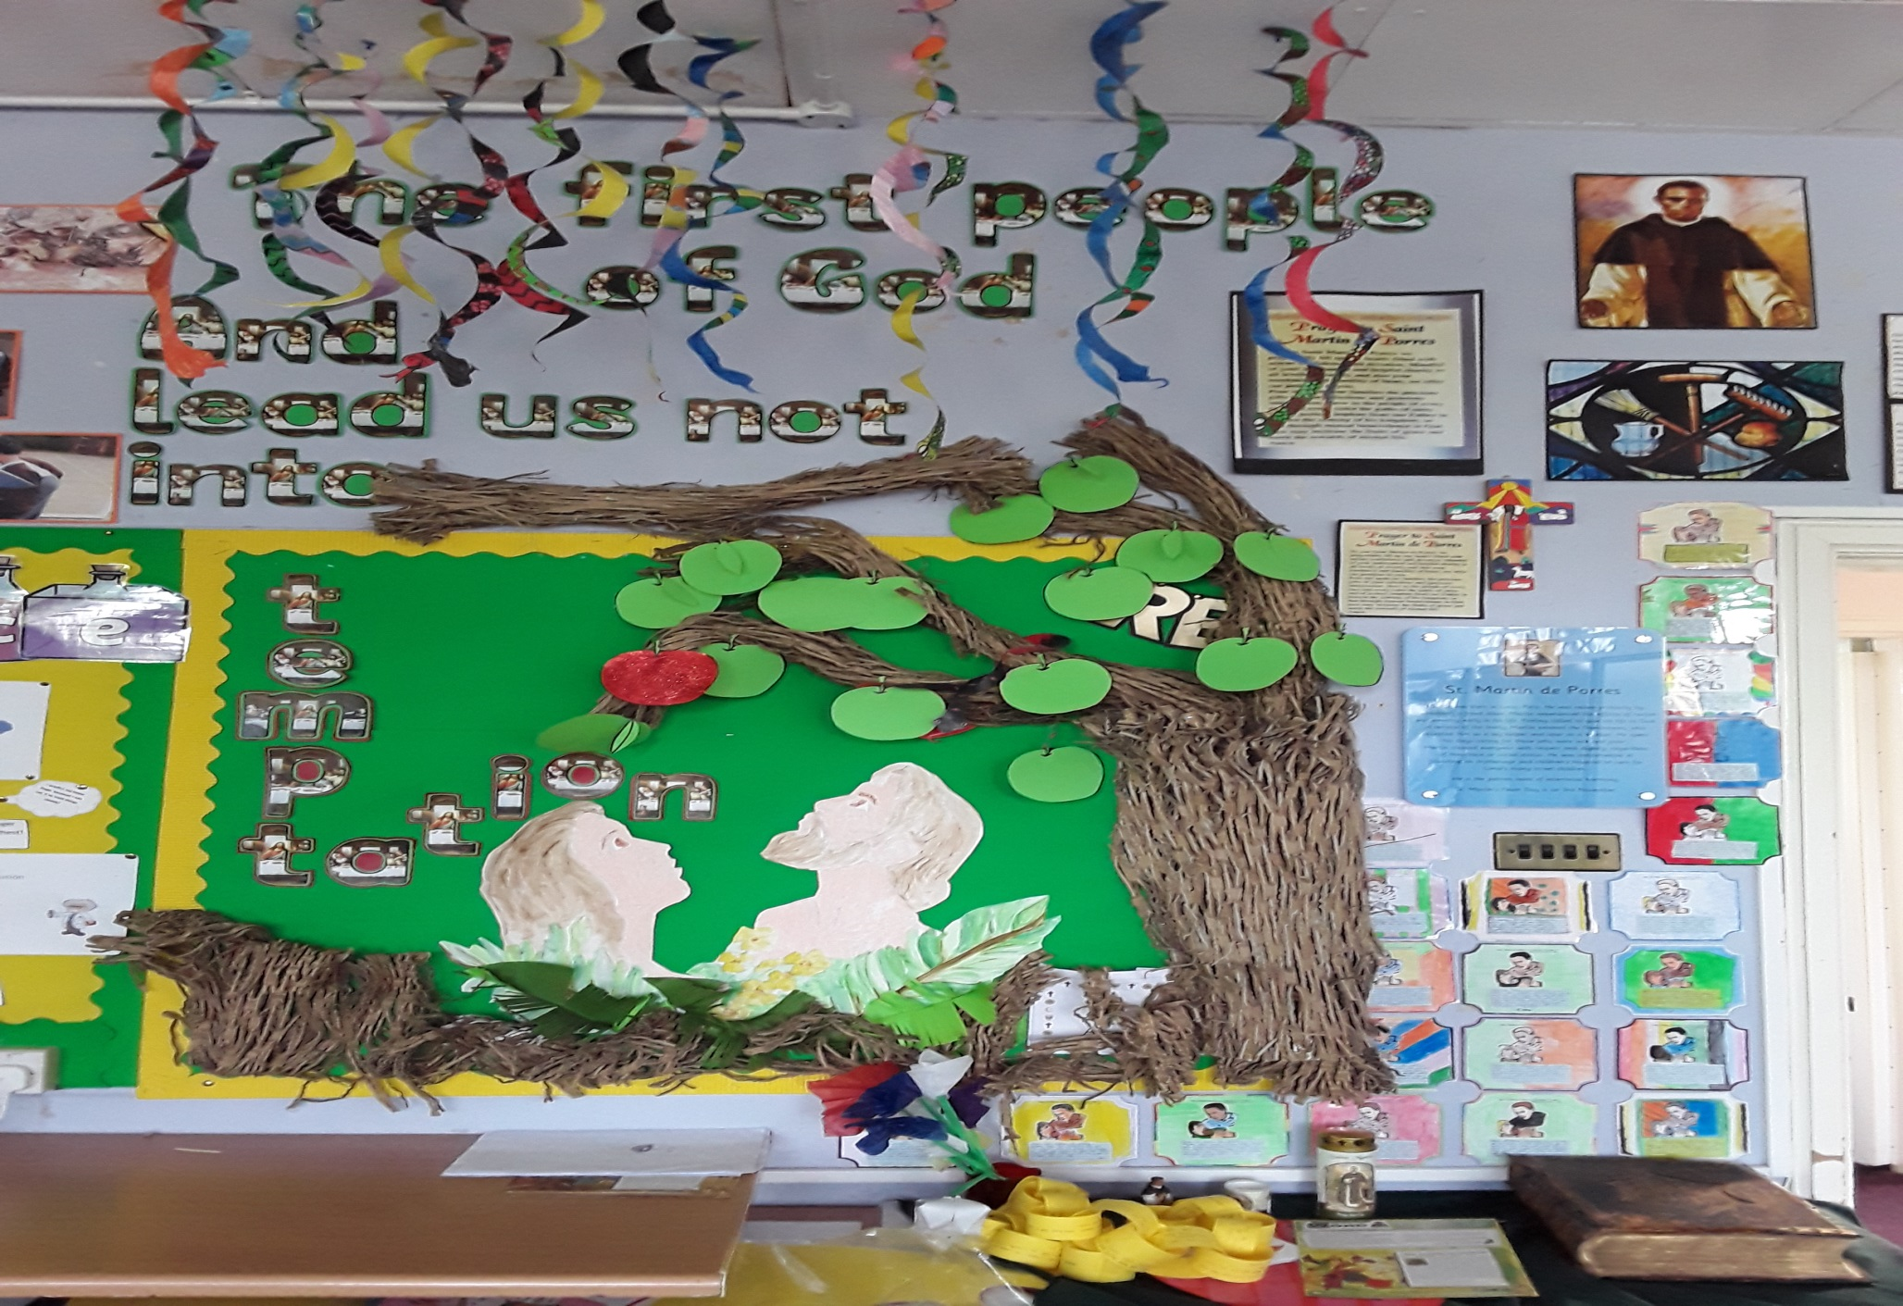

Slide 13
